Slide 1

Internet of Things Using Node-Red and Alexa
AnOJA rajalakshmi
Embedded Electrical and Computer systems
San Francisco State university, California
Notes:
Hello and Welcome. My name is Anoja Rajalakshmi. I am a recent graduate from San Francisco State University. I would like to present my paper on Internet of Things using node red and Alexa.
Internet of Things, is revolutionizing our daily lives and the way we interact with each other. Watches that read our e-mails while calculating our running speed, cars that connect to central databases for navigation and information retrieval, devices that monitor our health and send updates to our doctor and more.

Slide 2
What is IoT?
Internet of Things (IoT) means learning and interacting with millions of things including services, sensors, actuators, and many other objects on the Internet.
IoT allows objects to be sensed and controlled remotely across networks.
Notes:
So, What is IoT? IoT means learning and interacting with millions of things including services, sensors, actuators, and many other objects on the Internet.
The things are those wide variety of devices that are Wifi connected or has access to internet
It enables all things with embedded technology the ability to compute and communicate data via the Internet,
Thus, making virtually everything capable of being monitored, analyzed and acted upon by an array of computers with little or no human intervention.

Slide 3
Applications
PERSONAL
HOME AUTOMATION
HOME AUTOMATION
Baby Monitoring Sensors for skin temperature, breathing, body position
Wearables to automatically monitor movements, location and workout
Efficient home heating system make use of sensors, real-time weather forecasts and activity
Avoid disaster by use of sensors to track if a water pipe burst in your basement and alerts user
Keep Streets clean by alerting the municipal services when trash bins need to emptied
Effective use of electricity by calculating power consumption and reduce usage accordingly

Slide 4
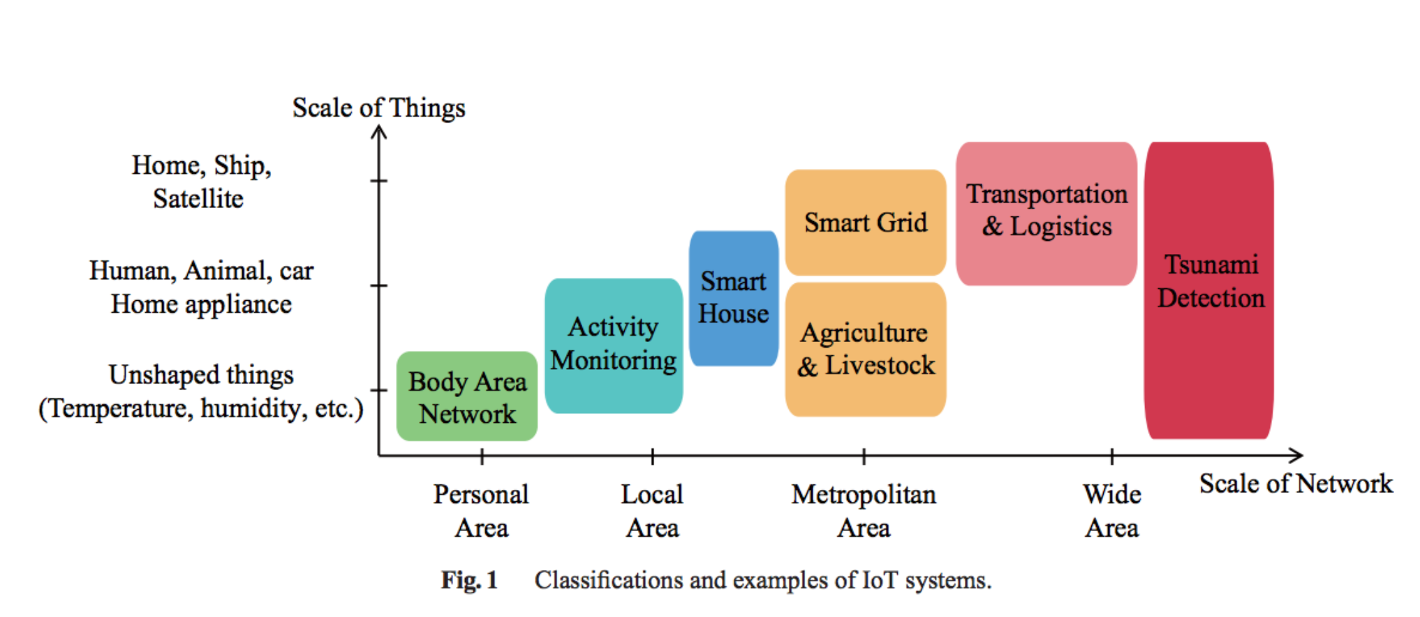
IoT Classification
Image Courtesy: Yuichi Kawamoto, Hiroki Nishiyama, Nei Kato, Naoko Yoshimura, and Shinichi Yamamoto, "Internet of Things (IoT): Present State and Future Prospects", IEICE Transactions on Information and Systems, Oct. 2014
Notes:
Body Area Network: Wearables, Implants,
Activity Monitoring: ECG, Tilt Sensor, Motion Sensors
Smart House: Smoke sensor, Smart window, Gas leak sensor, Camera
Agriculture: Smart sprinklers, pest control monitors, drones for field monitoring
Livestock: sensors on animals to monitor their health
Transportation: lost/stolen car tracking, smart parking

Slide 5
Evolution of Human Machine Interaction
Notes:
Human-Computer Interaction (HCI) technology plays a vital role in diverse fields such as education, industry, national policy and cultural development. This is true not only in developed countries but also in rapidly developing countries.
Until the late 1970s, the only humans who interacted with computers were information technology professionals and dedicated hobbyists. This changed disruptively with the emergence of personal computing in the later 1970s. Personal computing, including both personal software (productivity applications, such as text editors and spreadsheets, and interactive computer games) and personal computer platforms (operating systems, programming languages, and hardware), made everyone in the world a potential computer user, and vividly highlighted the deficiencies of computers with respect to usability for those who wanted to use computers as tools.

Slide 6
1. Screen and Keyboard, Text-bases UI computers.
Notes:
This is the very first generation of this kind of machines, which is familiar by most people. Through monitors, people can read the outputs from computers.
The input is captured by keyboards, which is the only way.
And the “Computers” act in the middle to carry out calculation or simply do the tasks given

Slide 7
2. Mouse, GUI computers
Notes:
A computer mouse is a pointing device (hand control) that detects two-dimensional motion relative to a surface. This motion is typically translated into the motion of a pointer on a display, which allows a smooth control of the graphical user interface. And that is also why it becomes accepted and loved by the population. This is also when computers really took off as a popular technology and came into our daily life.

Slide 8
3. Touch Screen, Portable devices.
Notes:
A touchscreen is an input and output device normally layered on the top of an electronic visual display of an information processing system. A user can give input or control the information processing system through simple or multi-touch gestures by touching the screen with a special stylus and/or one or more fingers
Touch screens really empower people to use our fingers to directly communicate with computers in the very native way. By doing this, the interaction with computers has been significantly simplified.

Slide 9
4. Voice-control
Notes:
this is an emerging trend for Human-Computer Interaction with the technology advancement in Artificial Intelligence and Information Retrieval. It can just listen to your voice, interpret and understand it, then act accordingly
Voice control on smart phones: Siri, Cortana
Google home: Hands-free help from the Google Assistant
Amazon Voice service called Alexa inside Echo, Echo Dot,

Slide 10
Applications of Voice Control and IoT
Control of Home devices
Outdoor
Security
Weather Monitoring
Navigation
Industrial automation
Notes:
We can create customized skills or voice commands which can be used in day today basic.
The reason for customized skill is that need for each individual may vary. Suppose if one likes watching news in the morning, other might prefer radio or a newspaper. So we can create our own skills to make our life easy.

Slide 11
Lets get into the project
Hardware:
MCUs: Raspberry Pi, Intel Edison, ESP8266, ESP32
Sensors: Photo Light Sensor, DHT11(Temp/Humidity), PIR, Door Sensor, Seed groove kit
Actuators: Servo Motor, LED, Relays, Buzzer
Hands free speaker: Amazon Echo
Web Services:
Alexa Skill Kit
Amazon Web Services(AWS)
IBM Bluemix
Twilio
Third party services: Open weather, Google account for email, Mosquitto
Protocols:
MQTT
HTTP
SSH

Slide 12
IoT Devices

Slide 13
Raspberry Pi 3 Model B
BCM43438 wireless LAN and Bluetooth Low Energy (BLE) on board
Quad Core 1.2GHz Broadcom BCM2837 64bit CPU
Features: GPIO, UART, I2C and SPI
1GB RAM
40-pin extended GPIO
4 USB 2 ports
Runs Linux and Node RED
Notes:
The Raspberry Pi is a low cost, credit-card sized computer that plugs into a computer monitor or TV, and uses a standard keyboard and mouse. It is a capable little device that enables people of all ages to explore computing, and to learn how to program in languages like Scratch and Python.

Slide 14
Intel Edison
Processor: 22 nm Intel® SoC that includes a dual-core, dual-threaded Intel® Atom™ CPU at 500 MHz and a 32-bitIntel® Quark™ microcontroller at 100 MHz
RAM: 1 GB
Wireless: Dual-band (2.4 and 5 GHz) IEEE 802.11a/b/g/n
40 general purpose GPIO features:
SD card: 1 interface
UART: 2 controllers
I2C: 2 controllers
SPI: 1 controller with 2 chip selects
I2S: 1 controller
GPIO: Additional 14 (with 4 capable of PWM)
Notes:
The Intel Edison is a computer-on-module offered by Intel as a development system for wearable devices and Internet of Things devices.

Slide 15
ESP8266
Low-cost microcontroller including full TCP/IP stack
Produced by Shanghai-based Chinese manufacturer, Espressif Systems.
CPU: 32-bit RISC Tensilica Xtensa L106 @ 80 MHz.
RAM: 64 kB for instructions; 96 kB of data.
WiFi: IEEE 802.11 b/g/n – WEP or WPA/WPA2 authentication, or open networks.
Features: 16 GPIO pins, SPI, I2C, UART, 10-bit ADC.
Slide Courtesy: https://github.com/apuder/iot-workshop/blob/master/doc/iot-workshop-slides.pdf
Notes:
The ESP8266 is a low-cost Wi-Fi chip with full TCP/IP stack and MCU (microcontroller unit) capability produced by Shanghai-based Chinese manufacturer, Espressif Systems.

Slide 16
ESP32
CPU: 240 MHz dual core Tensilica LX6 microcontroller with 600 DMIPS
Integrated 520 KB SRAM
Robust Design: industrial environments with an operating temperature ranging from -40°C to +125°C
2.4 GHz Wi-Fi and Bluetooth combo chip
Ultra-Low Power Management
Features:
3 x UARTs
3 x SPI
2 x I2S
12 x ADC input channels
2 x DAC
2 x I2C
PWM/timer input/output available on every GPIO pin
Notes:
ESP32 is a series of low cost, low power system on a chip microcontrollers with integrated Wi-Fi & dual-mode Bluetooth. The ESP32 series employs a Tensilica Xtensa LX6 microprocessor in both dual-core and single-core variations. ... It is a successor to the ESP8266 microcontroller.
As you see I have listed about 4 different microcontrollers those can be placed anywhere in the world, They need a simple protocol to talk to each other.

Slide 17
SENSORS
Notes:
DHT11 – Temparature/ humidity sensor
Door Sensor - one reed switch and one magnet, creating a closed circuit. If someone opens an armed door or window, the magnet is pulled away from the switch, which breaks the circuit and triggers an event.
Ultrasonic sensor – Detects the distance between objects
PIR – Passive Infrared Sensor 120 degree
Photo light sensor- resistance decrease when exposed exposed to light

Slide 18
ACTUATORS
Notes:
LEDs are the easiest way to simulate an output

Slide 19
Working of LED
Pin D2 is in output mode.
Whenever Microcontroller turns pin D2 high, LED glows.
This process can be controlled from a remote location using different techniques.
LED can be replaced by a Relay which acts like a switch
Notes:
The important matter is getting the pin high or low according to our application.

Slide 20
Working of Relay
Pin D4 is in output mode
Relay pins:
Vcc: connected to 3V3 of NodeMCU
Gnd: connected to GND of NodeMCU
Signal: connected to Pin D4
NO/NC: Normally open/close (Output)
C: Common (Output)
Output can be connected to higher voltage up to 250V.
Notes:
Reason: Limitation of demo –ing garage door open and other lights

Slide 21
MQTT
Message Queuing Telemetry Transport is a lightweight publish/subscribe protocol with reliable bi-directional message delivery.
Invented in 1999 by Andy Stanford-Clark (IBM) and Arlen Nipper. The original problem was to send sensor data from oil pipelines through a satellite link.
Runs on top of TCP/IP. Both client and broker need a TCP/IP stack.
Event oriented, therefore avoids polling
Notes:
Message Queue Telemetry Transport is an ISO standard publish-subscribe-based "lightweight" messaging protocol for use on top of the TCP/IP protocol.
It is designed for constrained devices and low-bandwidth, high-latency or unreliable networks.
This project uses MQTTfx for debugging MQTT messages.
MQTT.fx is a MQTT Client written in Java based on Eclipse Paho.

Slide 22
Publish / Subscribe
Clients are always connected with a broker.
Both publishers and subscribers are “clients”.
A client sends a message (publisher).
One or more clients receive the message (subscribers).
MQTT uses “topics” to determine which message is routed to which client.
A topic is a “hierarchical structured string”.
Notes:
The client that publishes is called publisher.
All those receives is called subscribers
Topic is a string word and is hierarchical meaning: home -> living room ->light or home -> living room -> TV will be represented as /home/livingroom/light or home/livingroom/TV

Slide 23
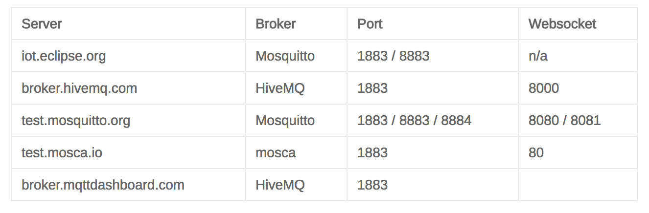
MQTT Broker
Source: http://moxd.io/2015/10/public-mqtt-brokers/
Notes:
The counterpart to a MQTT client is the MQTT broker, which is the heart of any publish/subscribe protocol. Depending on the concrete implementation, a broker can handle up to thousands of concurrently connected MQTT clients.
Testing against public brokers also ensures that our application can handle various types of topics and payloads. Because most of those public brokers are actively used by many people and we will find lot of messages being published. Also, this will help us to verify that our code is compatible to different broker implementations

Slide 24
Advantages of EC2
Affordable/ Inexpensive – Free trial for an year
Capability of running thousands of instances at a time
Highly Secured- Includes web service interfaces to configure firewall settings that control network access to and between groups of instances

Slide 25
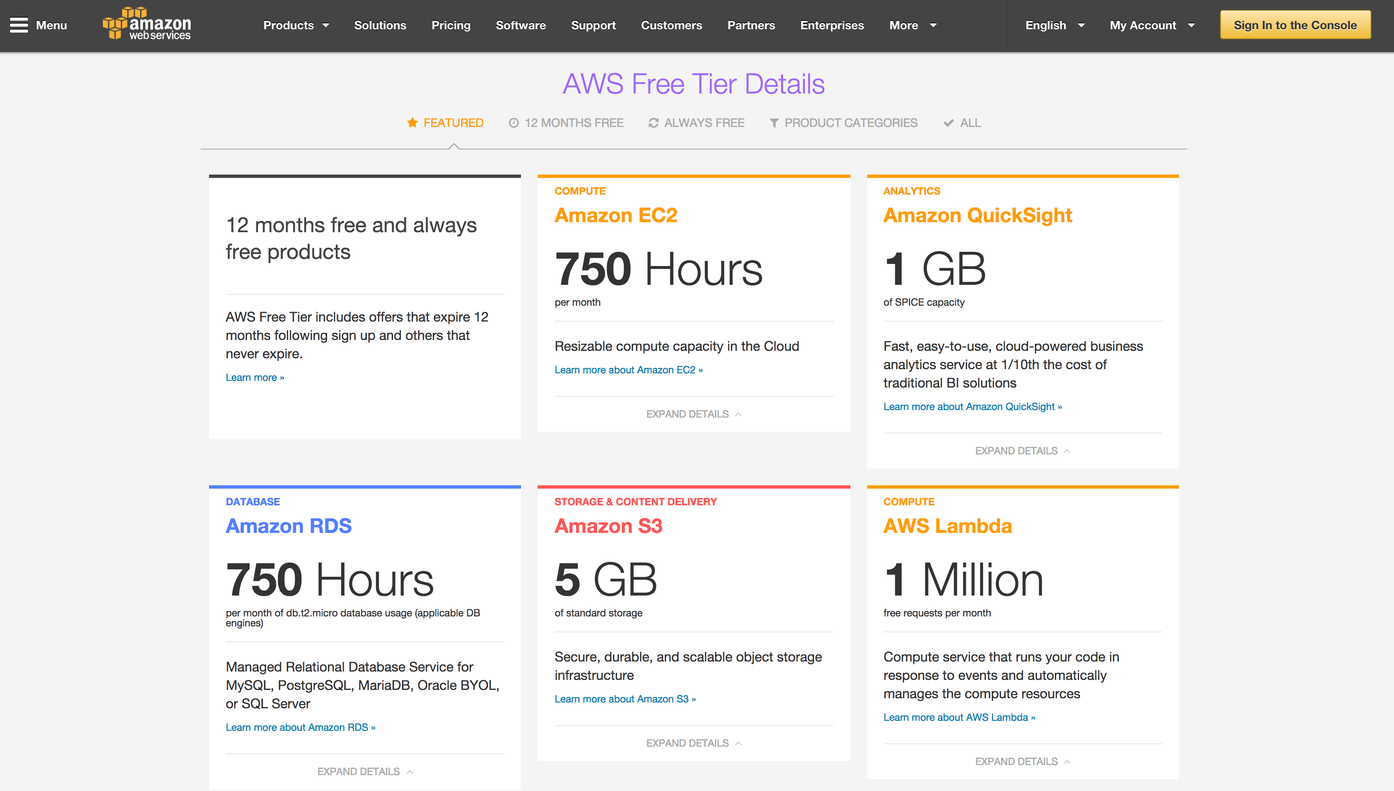

Slide 26
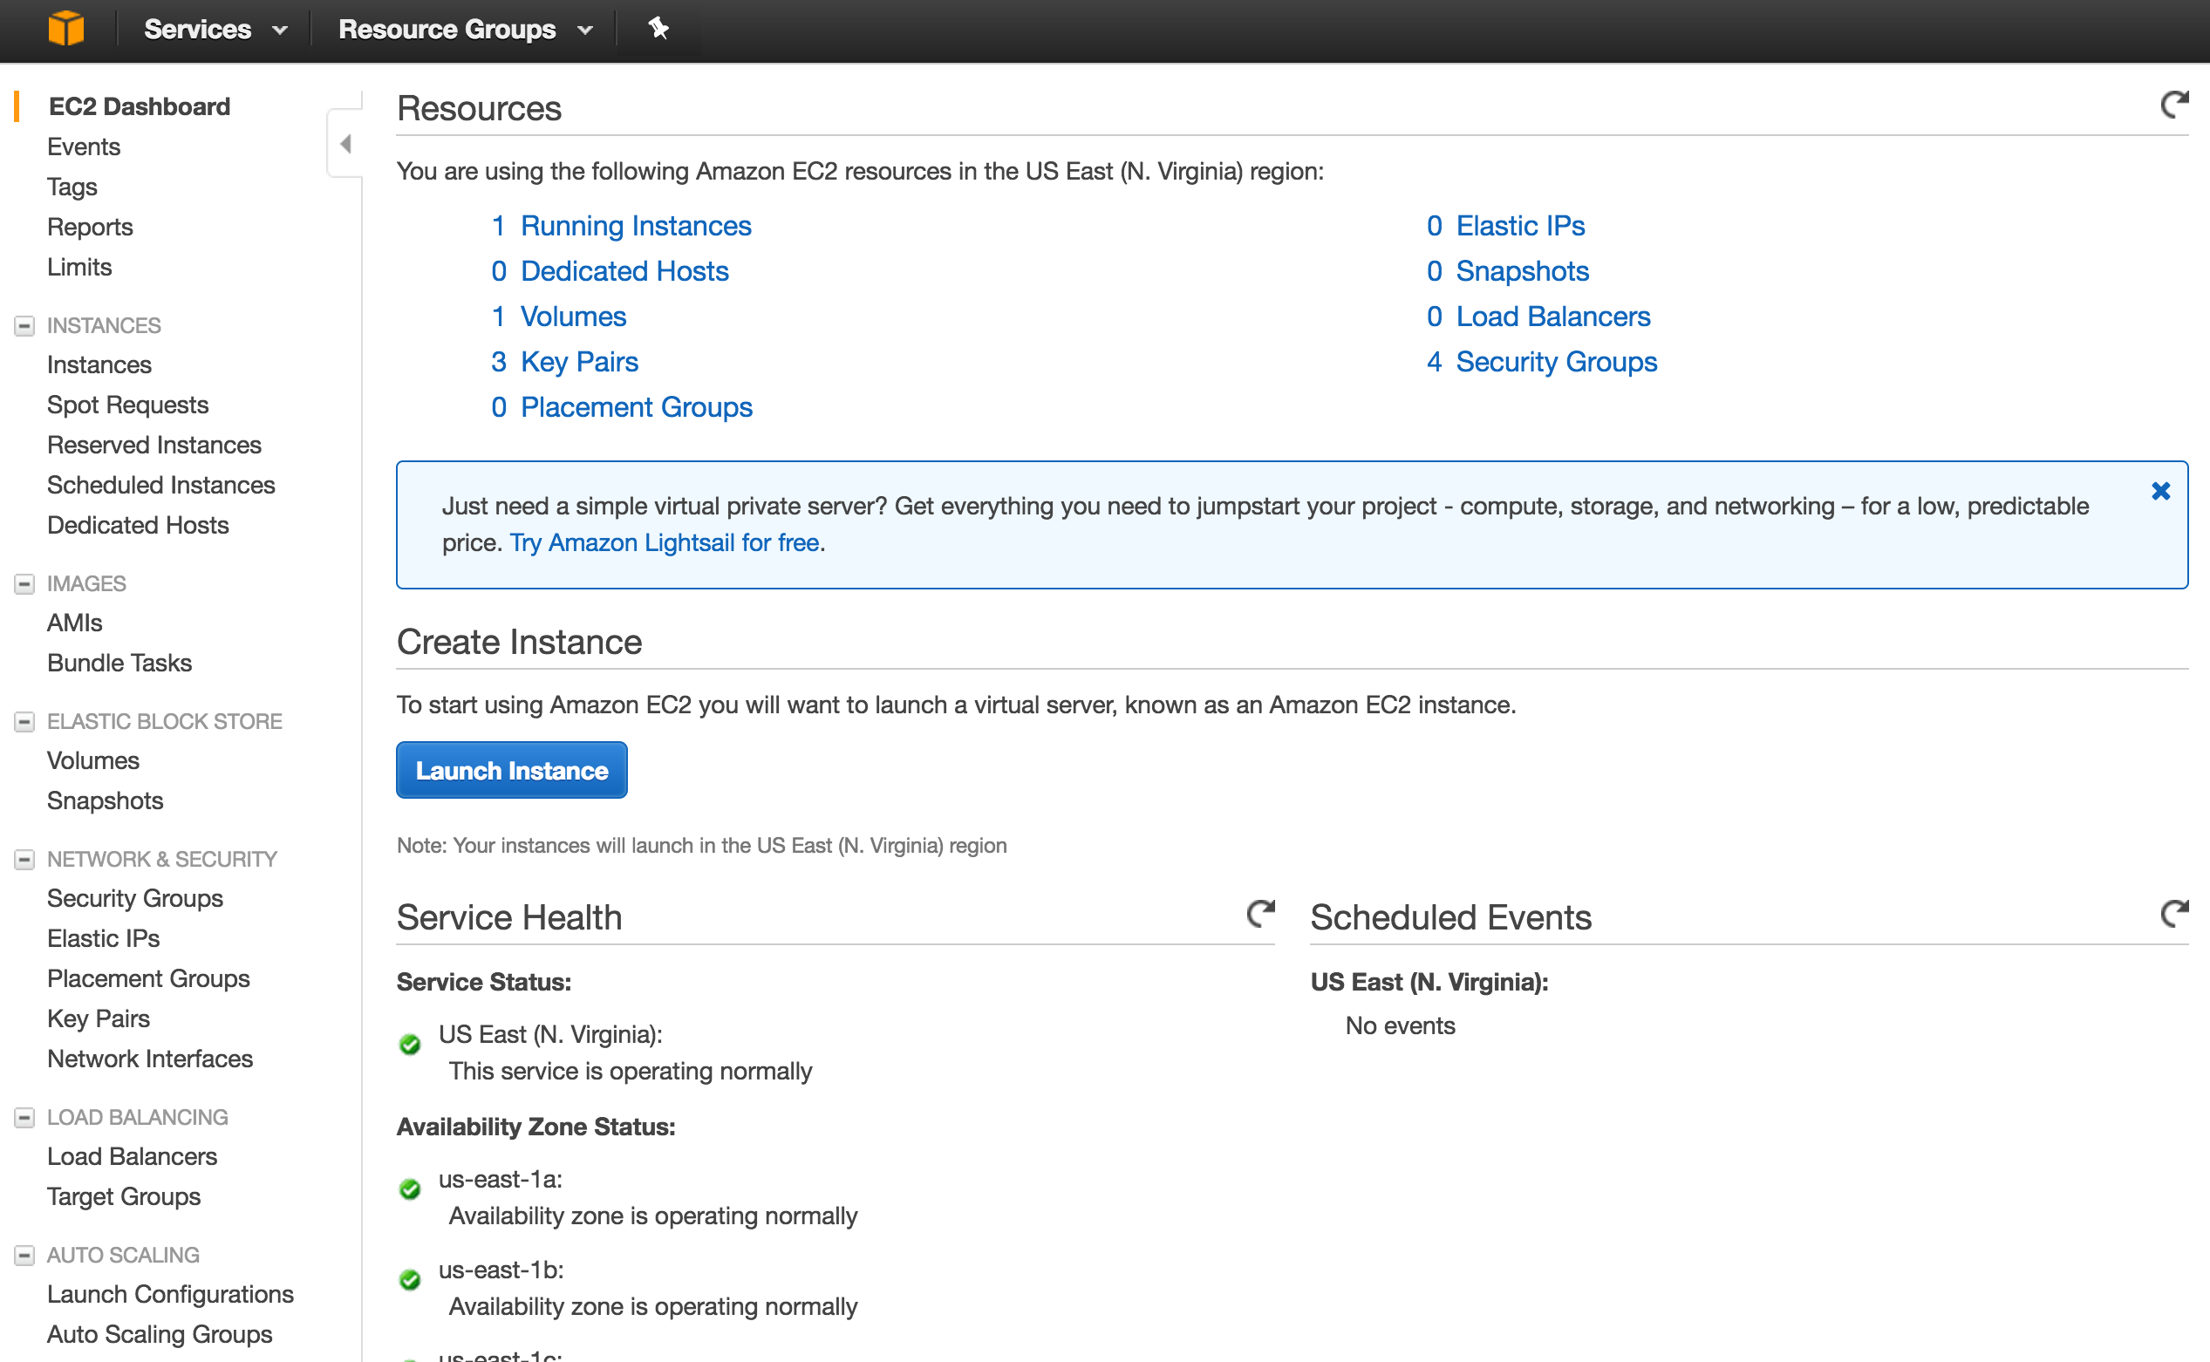

Slide 27
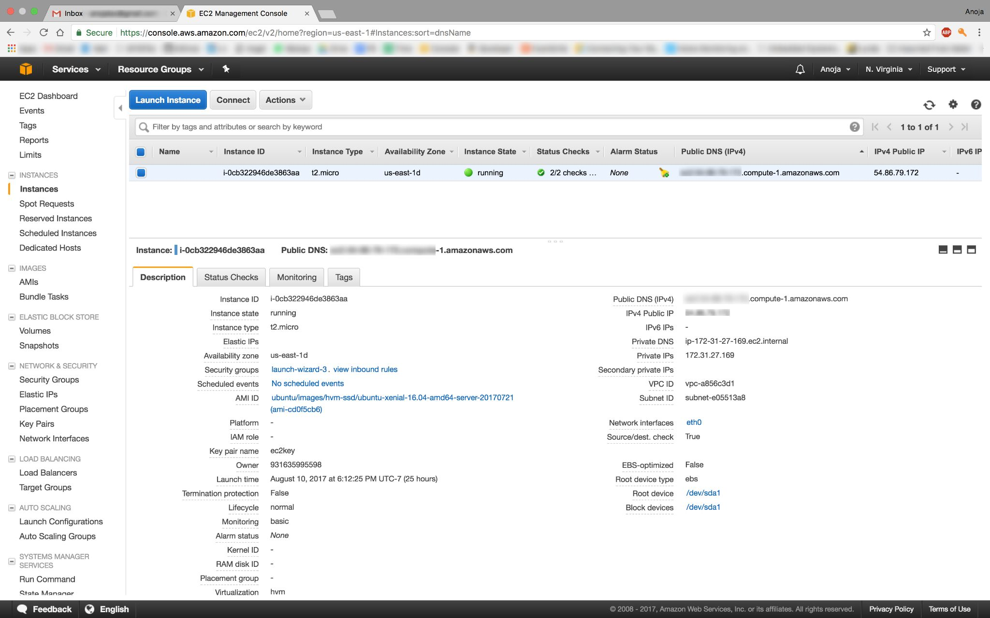

Slide 28
Alexa
Echo is powered by Alexa
Helps interact with devices in more intuitive way using voice
Developed by Amazon
When you ask Alexa for something, it triggers an Alexa Skills Kit, which is often linked to AWS Lambda to execute the code.
Courtesy: https://www.leverege.com/blogpost/alexa-skills-kit-tutorial
Notes:
Alexa is an intelligent personal assistant developed by Amazon, made popular by the Amazon Echo and the Amazon Echo Dot devices developed by Amazon Lab126. It is capable of voice interaction, music playback, making to-do lists, setting alarms, streaming podcasts, playing audiobooks, and providing weather, traffic, and other real time information, such as news. Alexa can also control several smart devices using itself as a home automation system

Slide 29
Basic Examples
Alexa, What is the weather today?
Alexa, trigger find my phone
Alexa, open garage door
Notes:
Project Demo: The project aims to control and automate devices using voice. The major advantage of the system is ease of management for the user by not to have his or her phone open and click on certain options to control things or go near the switch to turn it on.

Slide 30
Node-RED
Node-RED is a software tool for wiring together hardware devices, APIs and online services as a part of IoT
Node-RED provides a browser-based flow editor, which can be used to create JavaScript functions.
Elements of applications can be saved or shared for re-use.
The runtime is built on Nodejs.
The flows created in Node-RED are stored using JSON.

Slide 31
Flow in Intel Edison
Notes:
Node Red makes it easy to change a decision.
In the first flow, A photo light sensor input is send to a regulator that decides whether to on or off the relay board.
Assume that relay board has connection to a light switch.
The average reading of Photo sensor in this room is 4 lux (luminous flux per unit area). Regulator is set to 2. Lets change the value to 6 and see difference.
I am opening node red in Edison using SSH.
This will help us not to remove the device installed and update code inside.

Slide 32
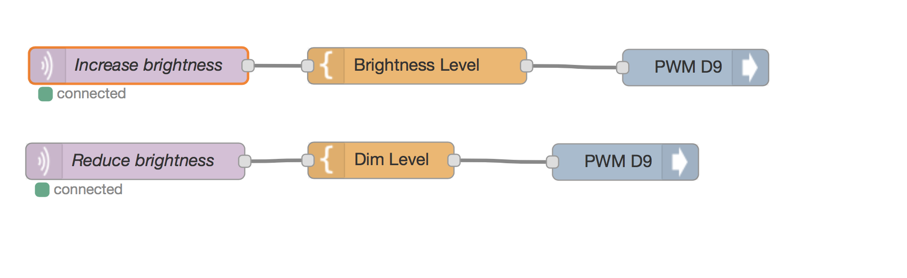
Notes:
For this flow the command comes from alexa.
Lets try that:
Alexa, ask demo to increase the brightness
Alexa, Ask demo to reduce the brightness

Slide 33
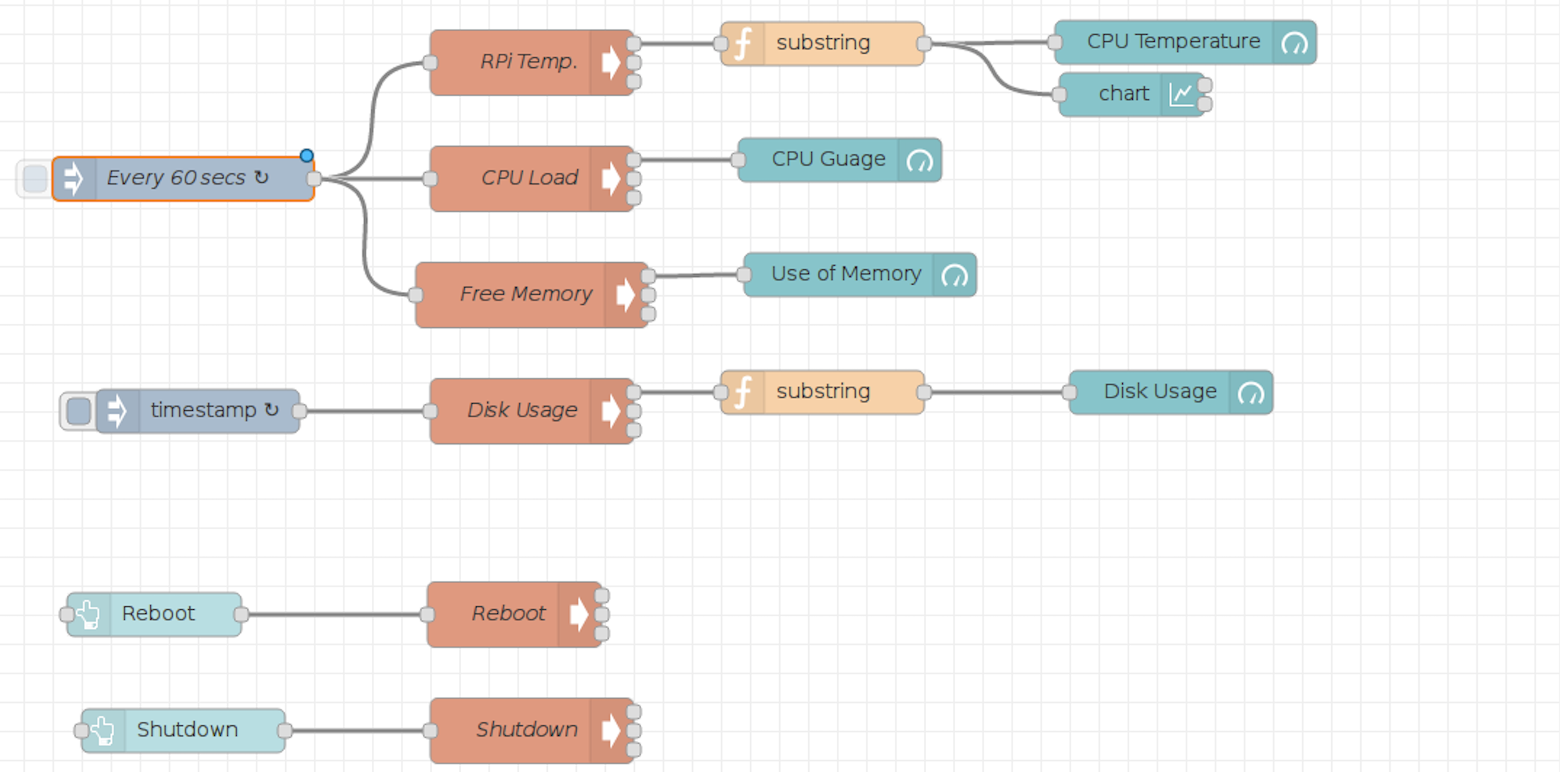
Flow in RPi

Slide 34
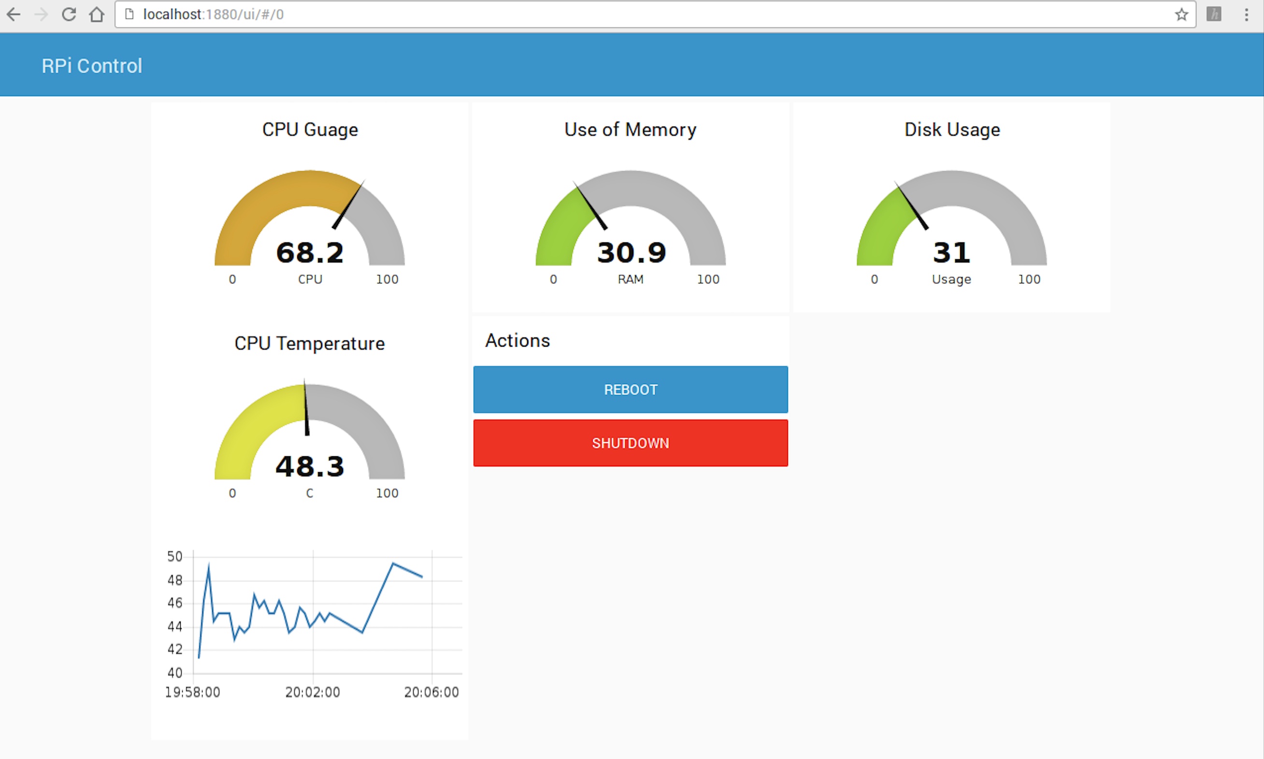
Dashboard for Pi

Slide 35
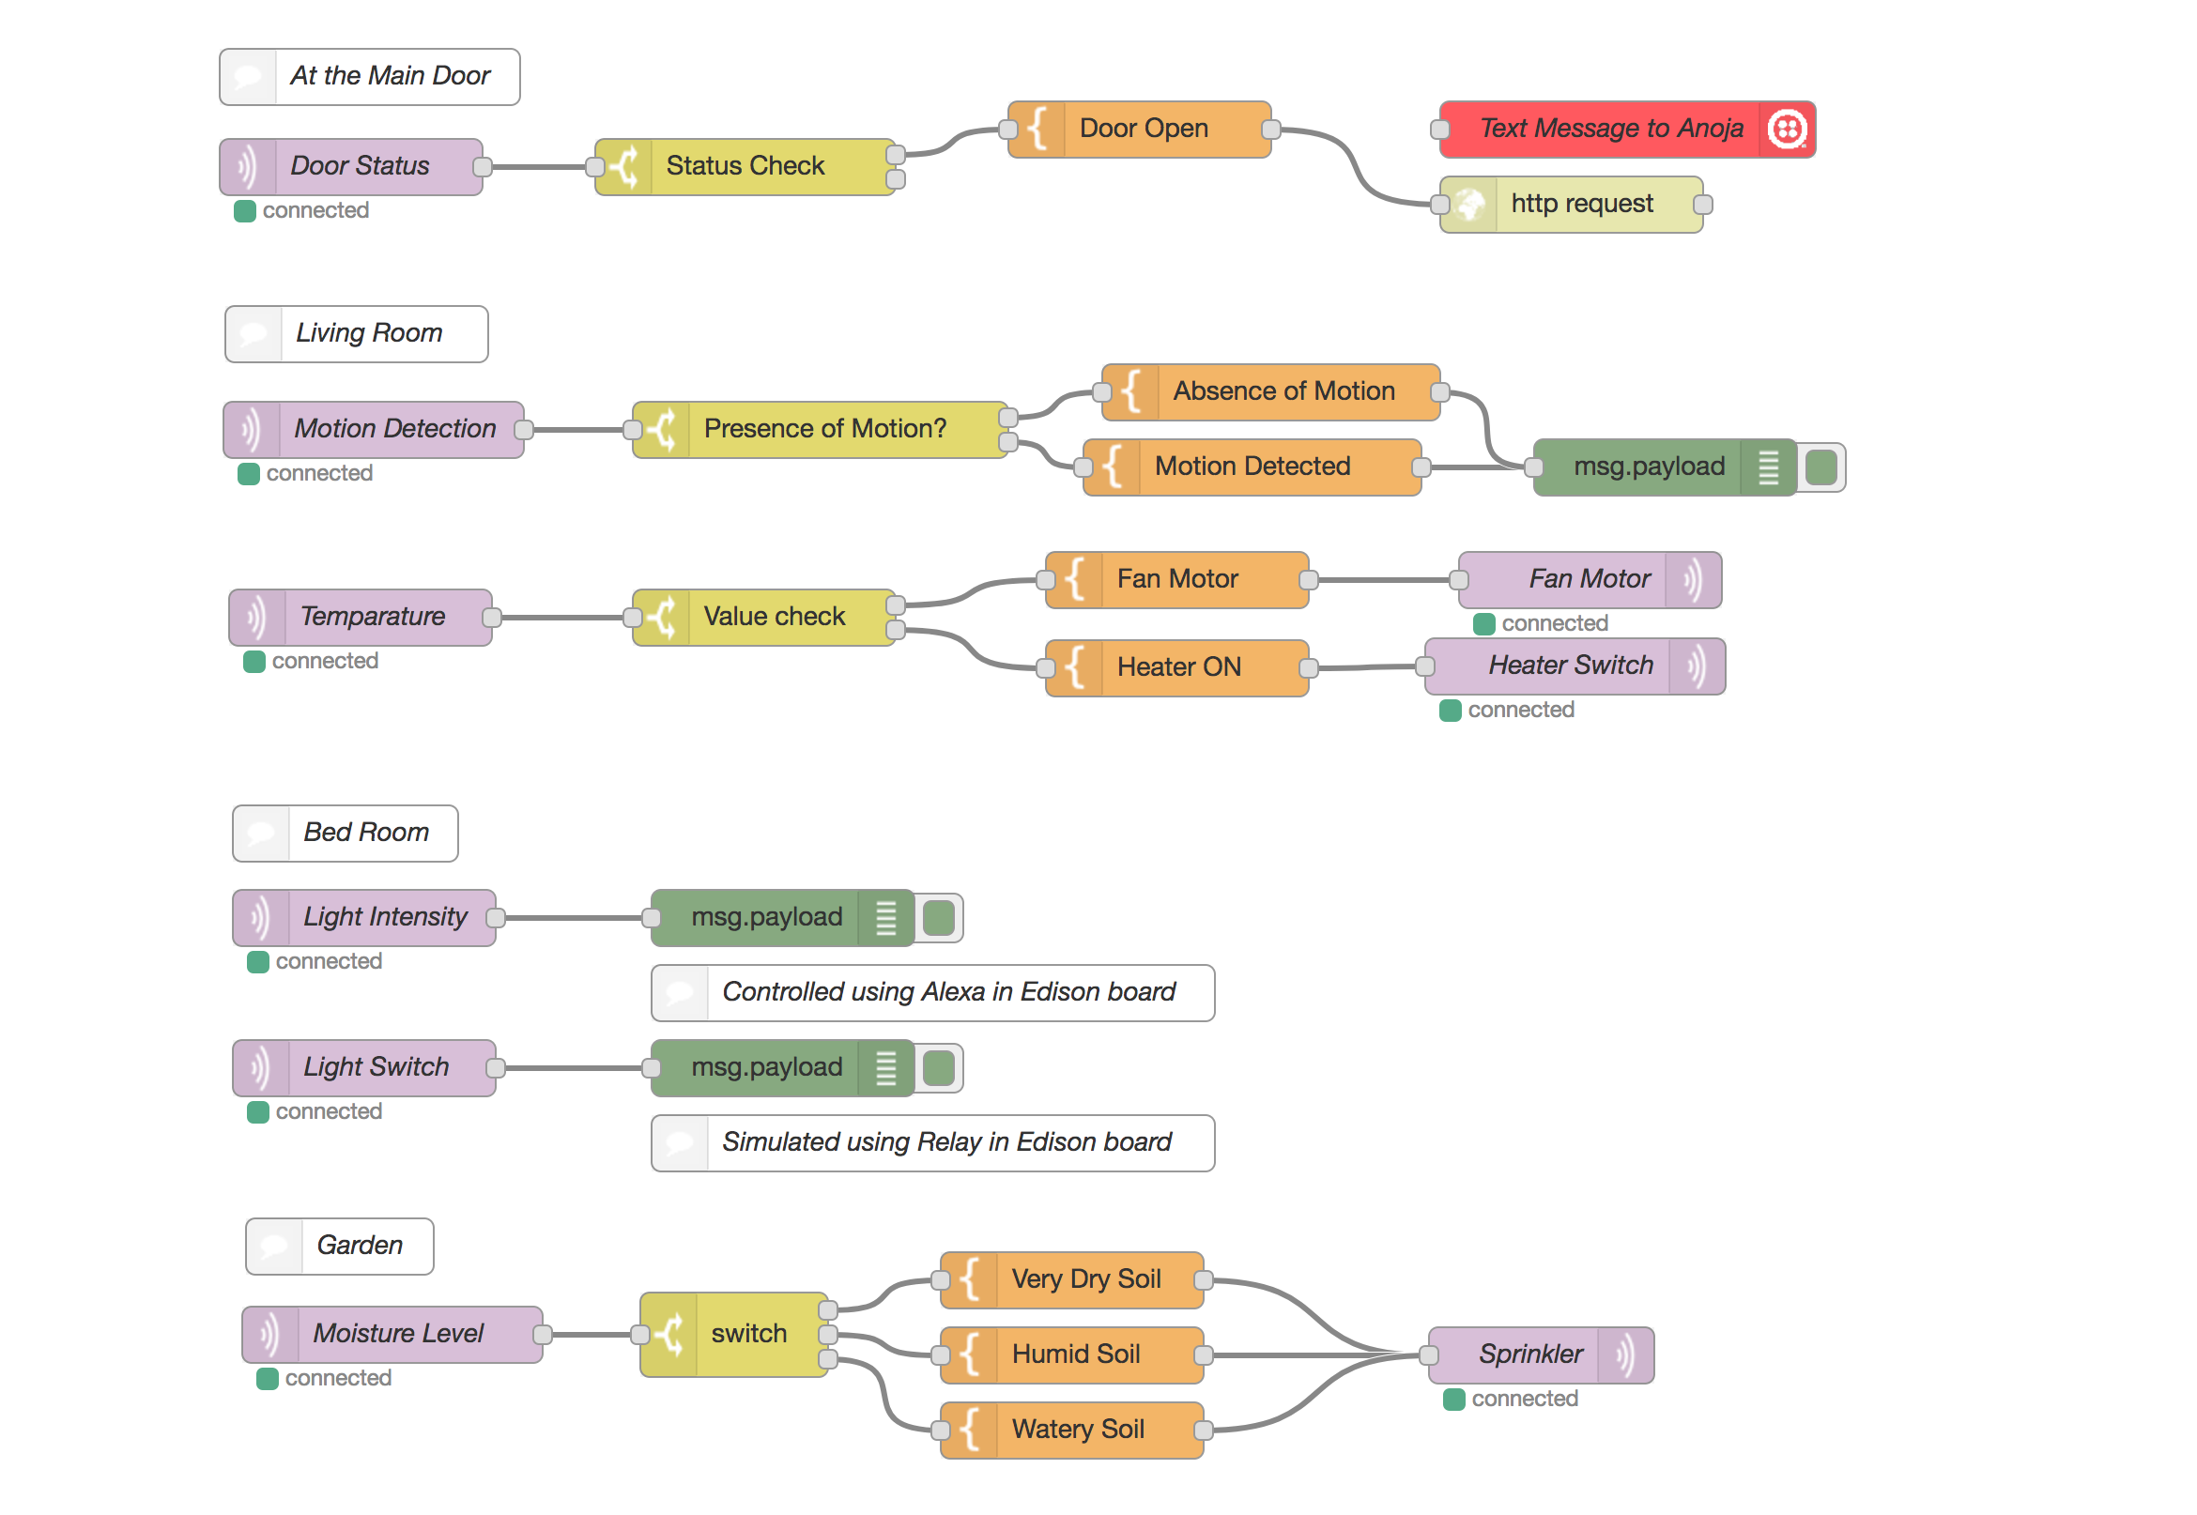
Master Control Flow in Raspberry Pi
Notes:
We have all the sensor input in the raspberry Pi. We could control any device in any iot devices connected to the cloud. This flow runs in the local server and is accessible only for this raspberry pi.

Slide 36
Flow in IBM BlueMix
Notes:
The flow we discussed before can be moved to the cloud. IBM Bluemix provide a platform that runs node red. This will help us control all these devices including node red from any part of the world.

Slide 37
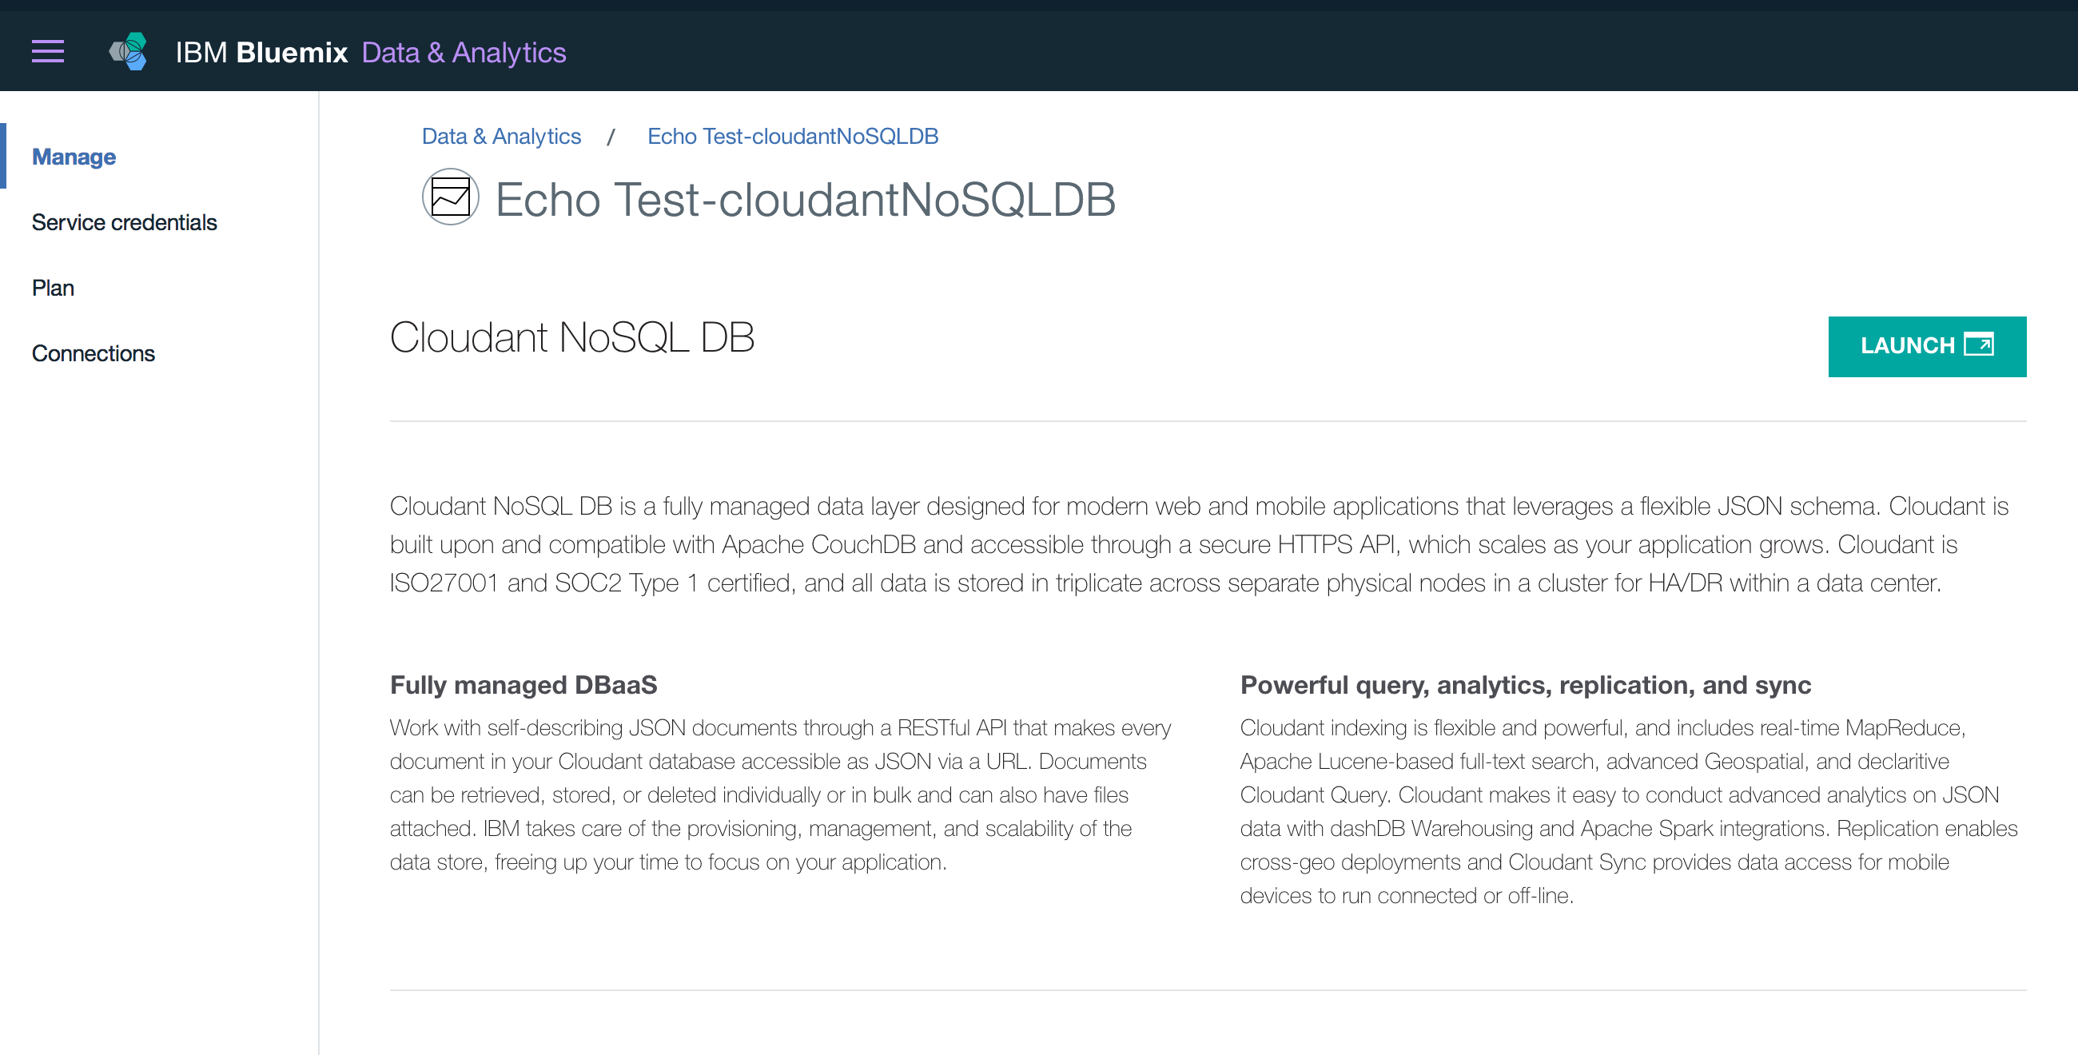
Cloudant data storage

Slide 38
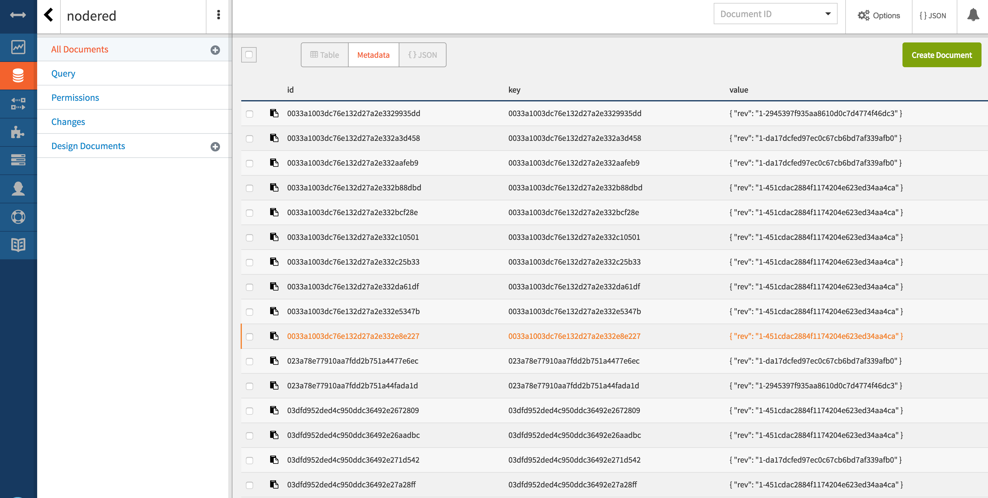
Notes:
Launch

Slide 39
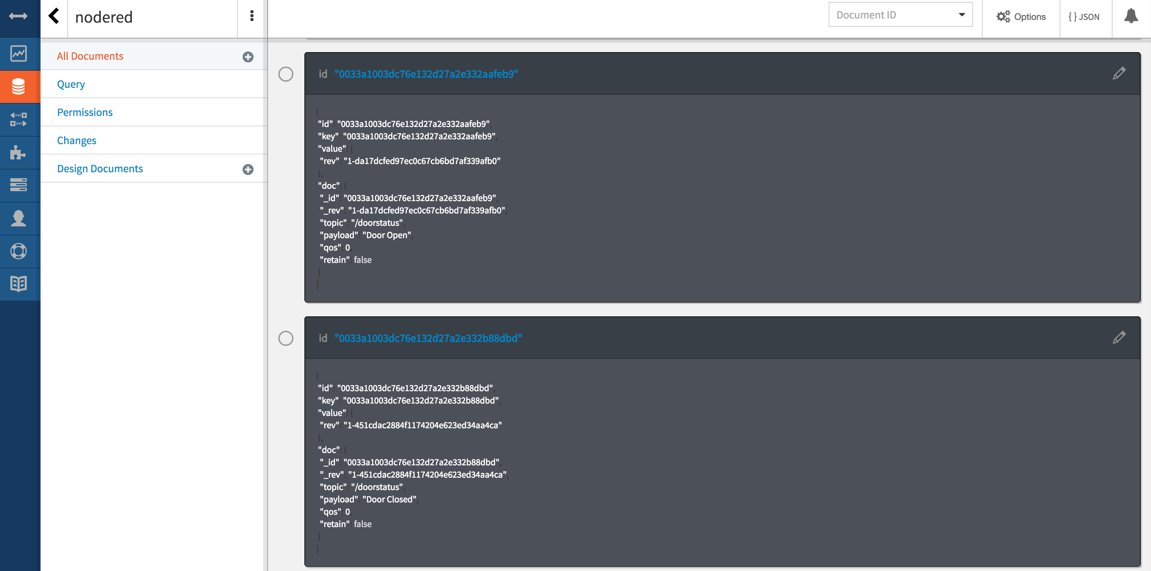

Slide 40
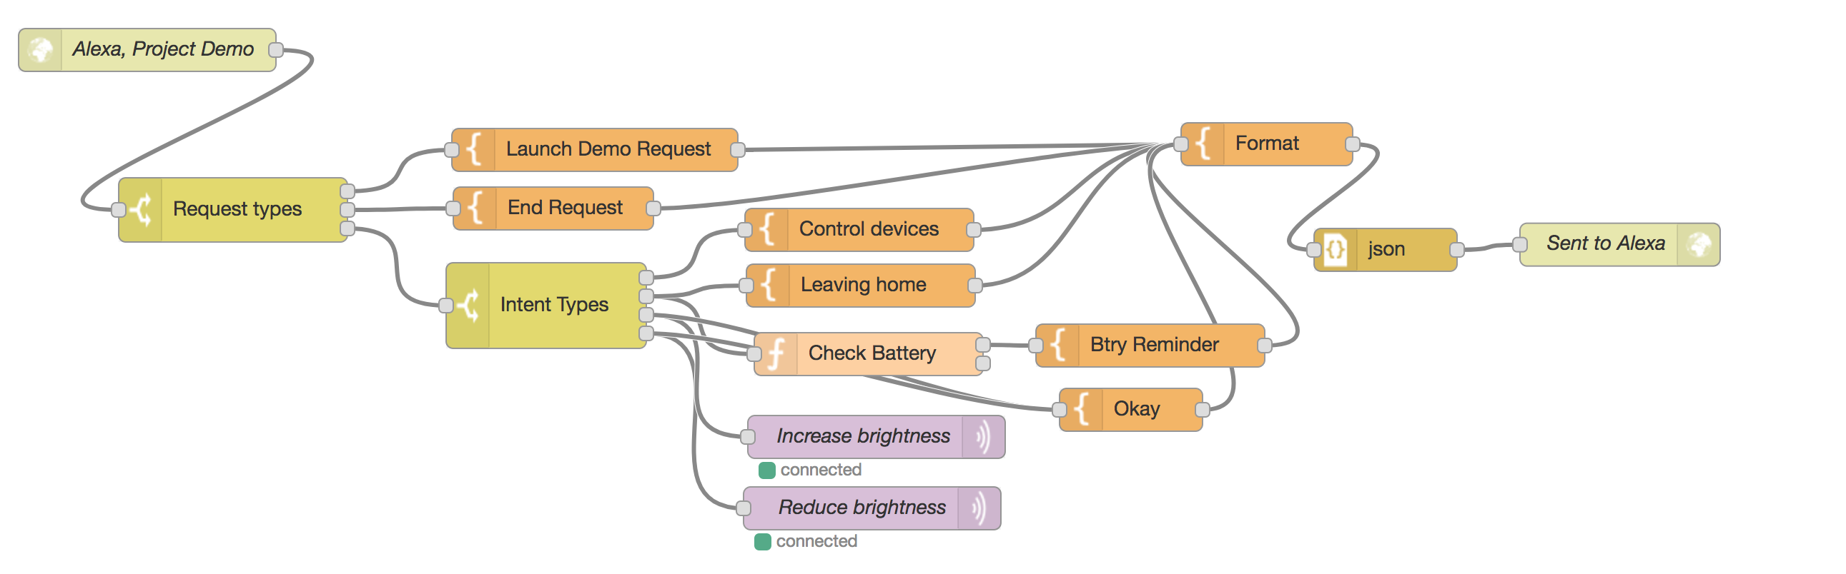
Demo

Slide 41
CONCLUSION
Use of Voice to control IoT devices
Need for effortless updates and connection using Node-Red
Scenario: Brightness control in Edison by changing Regulator value in Node-Red
Control on any device from remote locations
No limitation of distance

Slide 42
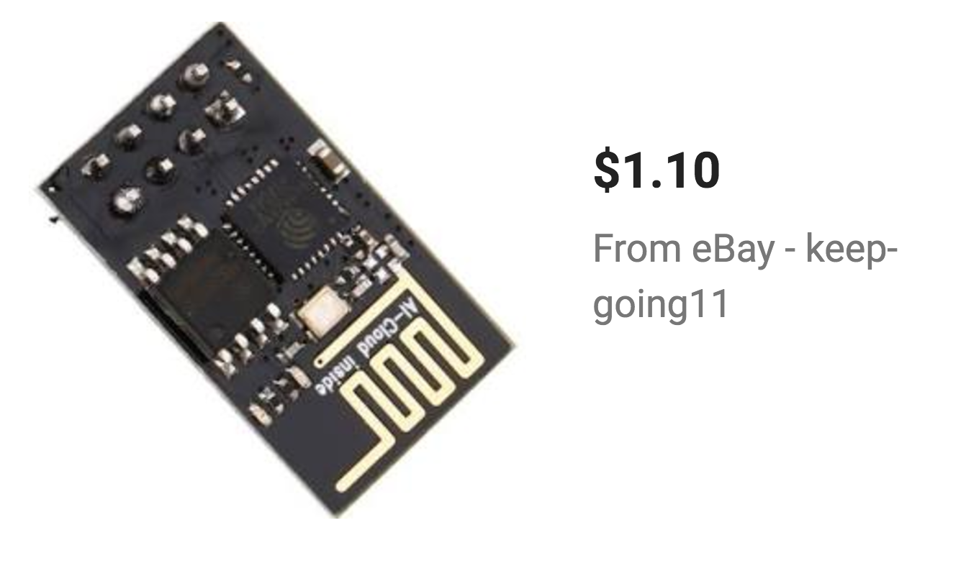
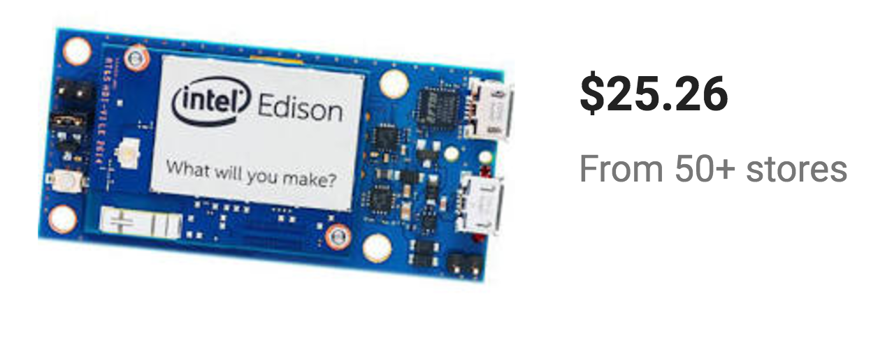
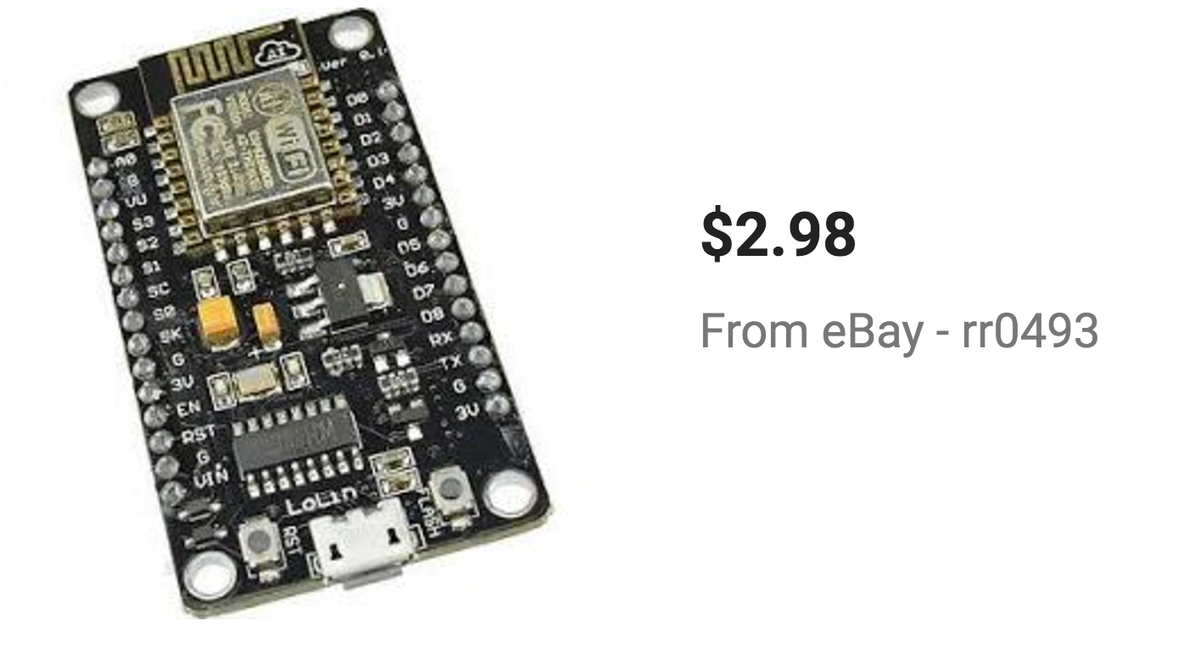
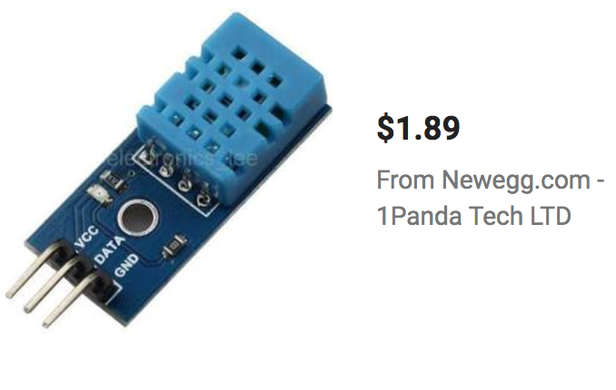
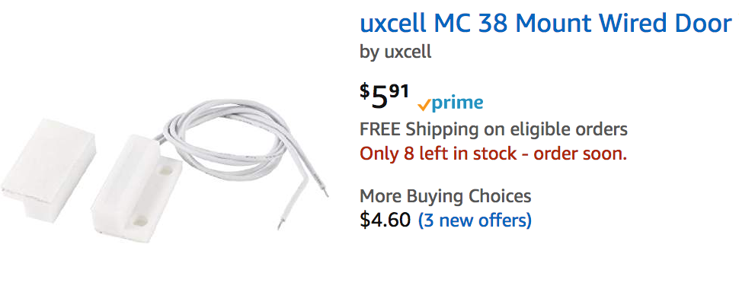
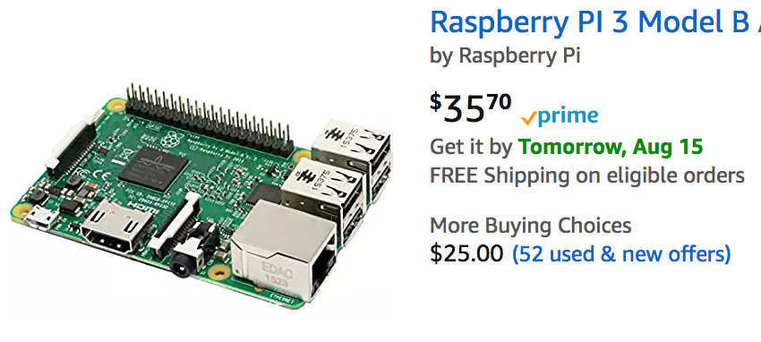
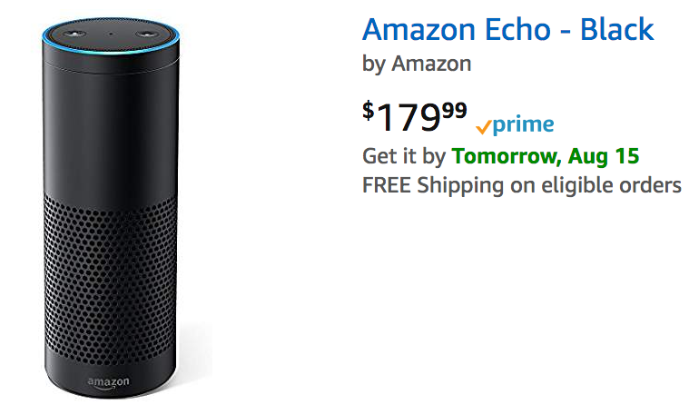
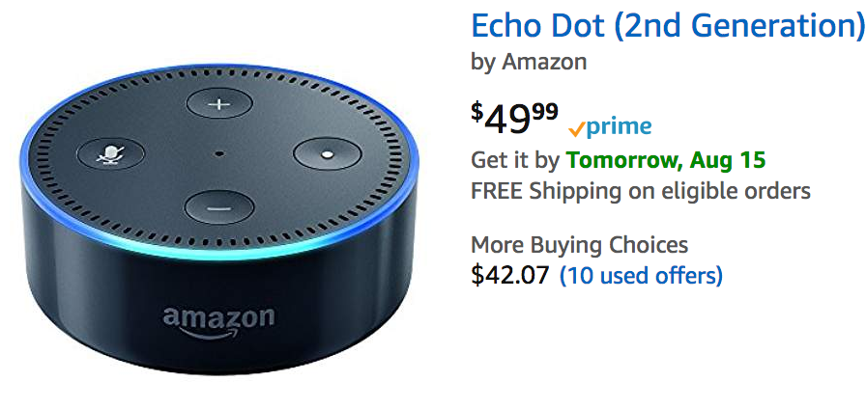
Cost Estimates

Slide 43
Thank You

